Slide 1
Preparing for a BAC full /
re-accreditation inspection
BRITISH ACCREDITATION COUNCIL Raising Standards in the Global Education Market

Slide 2
~
What Is The Purpose Of The Inspection?
To assess whether an institution meets BAC’s minimum standards through the gathering and assessment of relevant evidence from meetings, documentation scrutiny and other relevant activities
It should be supportive and developmental as well as judgmental
The inspection not only assesses what can be observed during the visit but also considers evidence that satisfactory standards are likely to be maintained in the longer term

Slide 3
~
The Importance of Good Preparation
BAC uses a rigorous and thorough inspection process in order to award accreditation to an institution therefore - the better prepared you are – the better outcome you are likely to get
The whole process will go smoothly and therefore lead to zero stress!
All of your staff will understand the inspection process and – therefore – be able to provide appropriate support during the inspection
The inspection team will be able to carry out their work speedily and efficiently – this can only be a positive!

Slide 4
~
The Preparation Process - Dates
Your key staff need to be available on those dates
Confirmation of dates – the BAC office will be in touch to arrange suitable dates for the inspection
You need to have teaching/training running on those dates (a good cross section of your courses if possible)
You will need to have some teachers/trainers available to be interviewed
Please respond quickly to the request for dates so that we can organise an appropriate inspection team for you
You need to have students present to be interviewed

Slide 5
~
The Preparation Process - Documents
Anti-bribery and anti-corruption policy – review and note – it is great that inspectors are well looked after – however it is important that we act at the highest ethical levels at all times
However, the Lead Inspector (LI) may request a working lunch – sandwiches for example
Data collection form – read the guidance included in the form and complete it accurately – it provides a snapshot of your activity/provision at the time of the inspection
Brief your students about the inspection and its purpose – let them know that – if they are asked any questions – they should be honest as no individuals’ names will be disclosed

Slide 6
~
The Preparation Process – Other Matters
Check the details of the proposed inspection team members and check there is no conflict of interest between your institution and the team - if there is – please flag it up and a new team can be proposed
Let the BAC office know if you ever enrol students / participants under the age of 18
If you have any concerns or questions at all – please let us know!
Please respond promptly to all requests from the BAC office

Slide 7
Completing The Self Evaluation Report
- You will be asked to complete a self-evaluation report – this may be done at the time you complete the application form
Please return the completed report as quickly as possible
- You may be asked to up-date the report just before the inspection
- Please review the Completing Your Self-Evaluation webinar
- What follows is an extract from the webinar

Slide 8
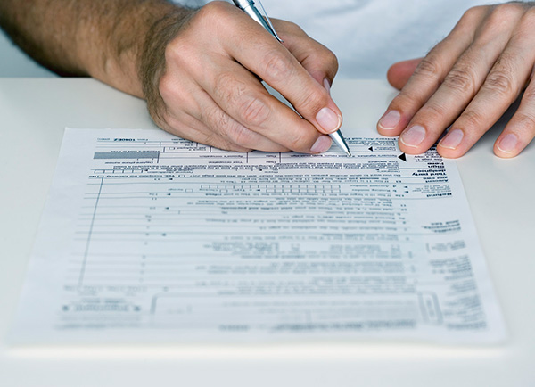
Self Evaluation - Purpose
To evaluate your performance – using a process of reflection to identify strengths and areas for development
To be part of your integrated approach to internal quality assurance - not just for the inspection
To audit what you do across your provision
To set actions to help you improve and develop
To help to prepare for the inspection and identify areas on which to
focus
It follows the standards relating to the relevant accreditation
scheme

Slide 9
Self Evaluation – Benefits
Identifies your strengths and weaknesses
Opportunity to connect with and involve your team in an audit of how well you are doing and what you can improve
Opportunity for greater ownership and responsibility among the team
Creates a state of readiness for the inspection so that everyone understands what is expected
Improves cross organisational co-operation for large providers
Provides familiarity with the inspection criteria
The standards have been put together with sector input and represent best practice in the delivery of a quality educational experience
Increases organisational efficiency and enhances service

Slide 10
The Self-Evaluation Report Form
Provides up-to-date background information on your institution and its provision (this forms part of the inspection report)
Follows the standards and key indicators relating to the specific scheme
It asks you to identify your key strengths and areas for further improvement as an overview of your performance

Slide 11
The Self-Evaluation Report Form
You need to provide the supporting evidence for these judgments
You need to think about how you comply with or not any relevant statutory requirements and what you will do in the case of non-compliance
It requires you to assess how you meet the individual key indicators and what you need to do to further improve and develop
It requires you to put together an action plan to address the areas for further improvement/ development

Slide 12
Contact with the Lead Inspector
The Lead Inspector (LI) will be in touch to organise the inspection.
The LI will cover the following main areas:
Requesting the class timetable for the days of the inspection so that lesson observations can be arranged
Recommending that you review the contents of your last inspection report (including any action points or recommendations for improvement) and ensure any outstanding matters have been addressed
Requesting that all documentation (of which a list will have been provided by the LI, which will include documents sent with the application form) is made available at the inspection and is clearly labelled, ideally against the relevant standards/key indicators and placed in the inspection base room
You will be advised that you will be asked to sign a declaration that you comply with all statutory obligations for example regarding health and safety and safeguarding (if applicable), so please check that you do comply

Slide 13
Contact With The Lead Inspector
The LI will also cover the following main areas:
Requesting the organisation chart - showing the names/titles and key responsibilities of the staff linked to the standard areas covered by the relevant BAC accreditation scheme - so that appropriate meetings can be scheduled
Requesting a list of the students, who will be present during the inspection - including information about their age, gender and ethnic background - to arrange a meeting with a cross-section of the students
Checking the accuracy of the introduction to the inspection report
Confirming that a draft inspection timetable will be sent for you to agree or request amendments
Setting up the base room where the inspector(s) will work
Please respond to the inspector’s requests as promptly as you can to ensure the inspection can be prepared well, in advance

Slide 14
You Are Ready!
Your inspection is arranged
You have read and completed all the necessary documentation
You have been in contact with the Lead Inspector
You know what will happen during the inspection
You know what to expect
Good luck and we hope that you find the inspection to be a useful and constructive experience!

Slide 15
Preparing for a BAC full /
re-accreditation inspection
THE BRITISH ACCREDITATION COUNCIL Raising Standards in the Global Education Market
Any questions please contact us
Email: info@the-bac.org Tel: + 44 (0) 300 330 1400 Twitter: @BAC_Education Skype: BAC-GB

